Slide 1

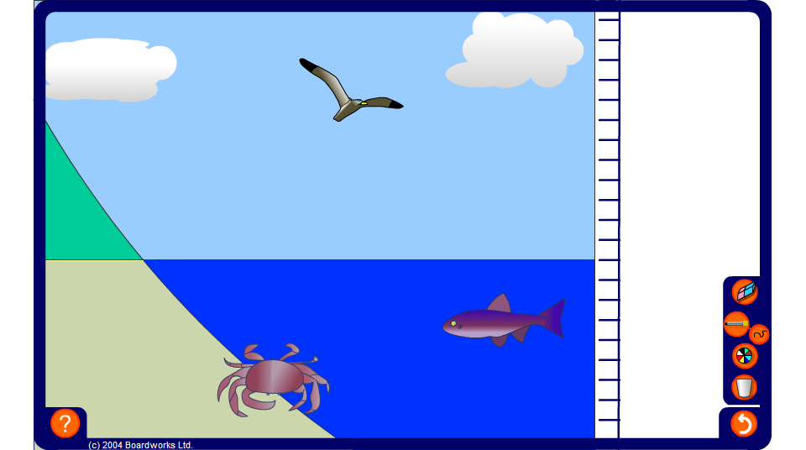


Sea level
Notes:
Use this activity to introduce negative integers in the context of sea level.
Ask questions based on the diagram and drag the images to illustrate the answers.
For example,
The crab craws 12m up the sand bank. What is his new position?
How many metres does sea gull have to move downwards to catch the fish?

